Slide 1
XML Generator
Joginder Sharma

Slide 2
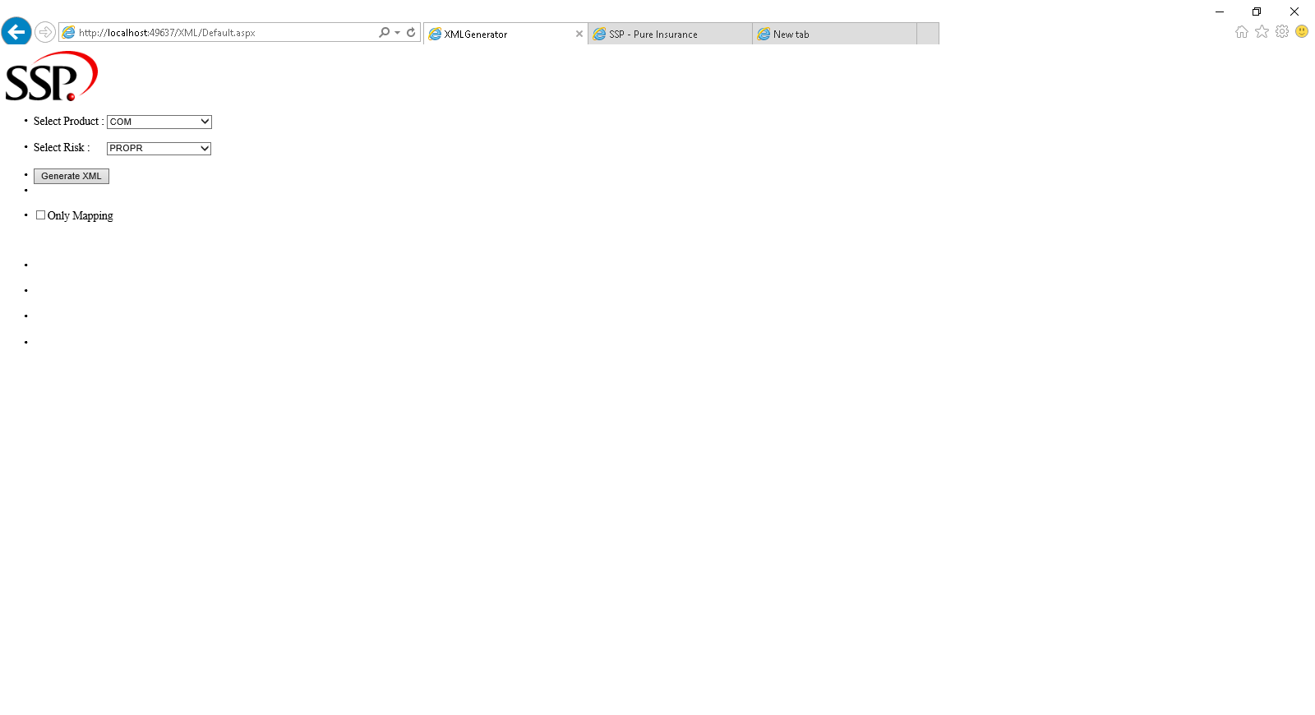
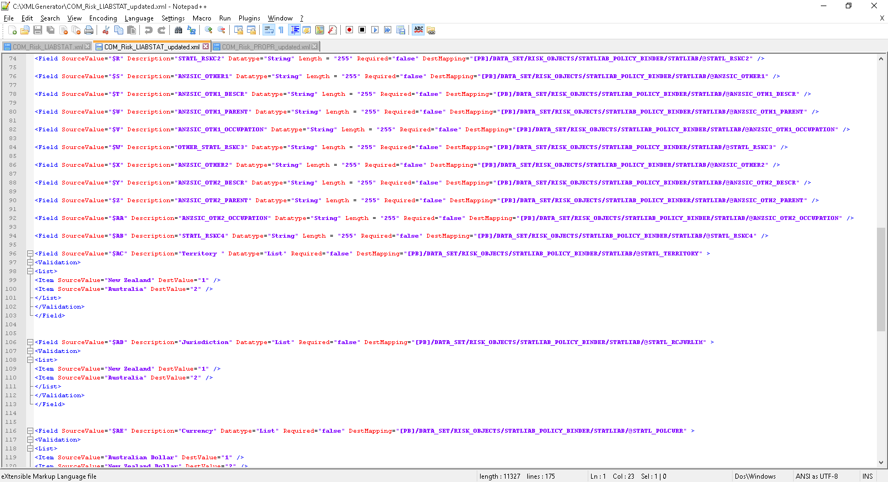
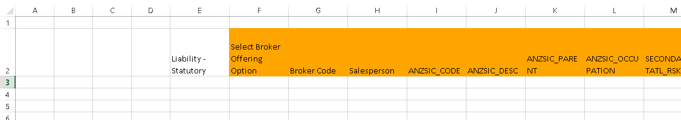
Introduction
It’s a Web application Which is used to :
Generate XML Configuration file.
Map fields with Excel Spread Sheet.

Slide 3
Why We Need
Reduce Manual work to generate XML configuration file.
Speed Up the process

Slide 4
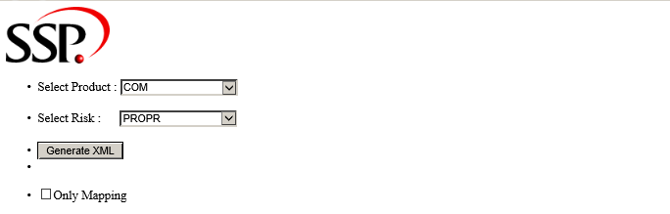
How It Works?
Create a Folder Named : “XMLGenerator” in C drive
Select product and risk to generate XML file as shown below.
(You can select “All” option in Select Risk to generate all risk xml in single file )

Slide 5
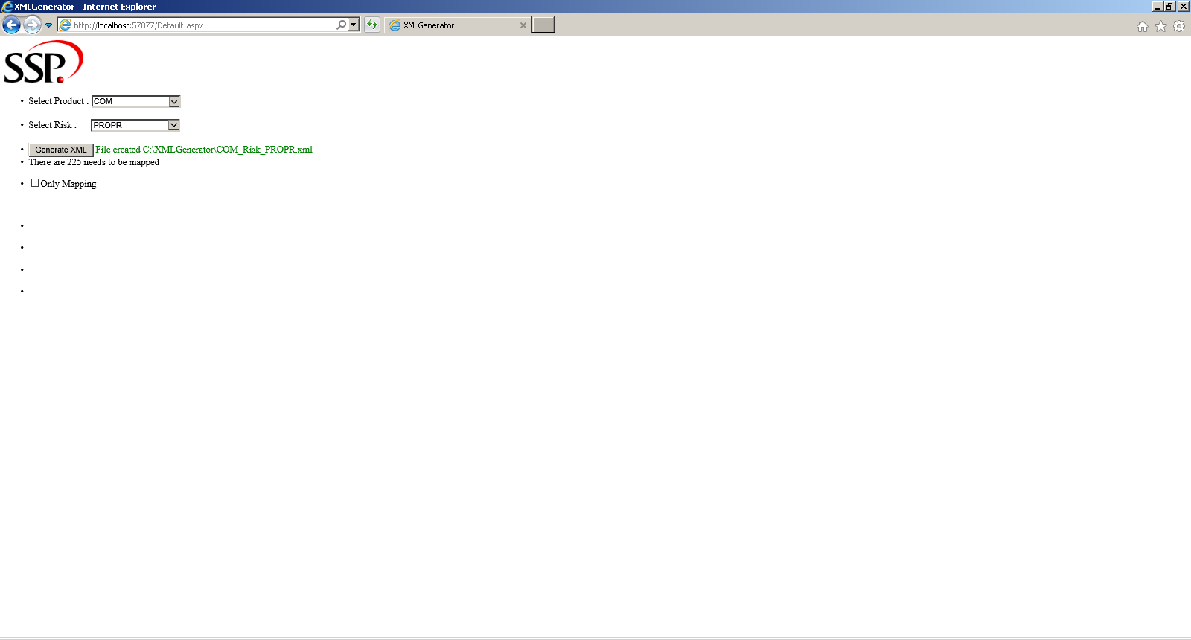
Click on Generate XML button. Below screen will getting back.
Your XML file is generated in C:\XMLGenerator\ named as : <Product_Name>_Risk_<Risk_Name> as shown below.

Slide 6
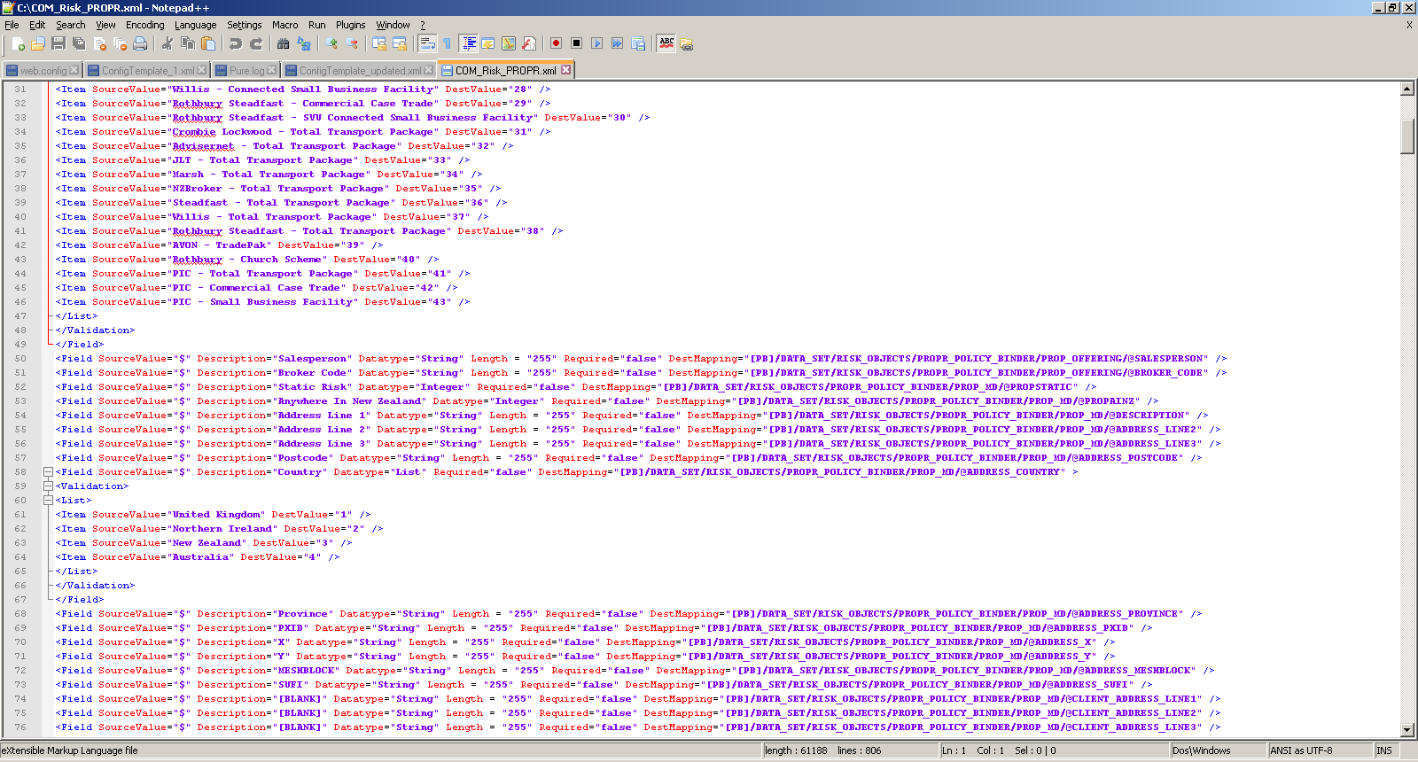

Slide 7
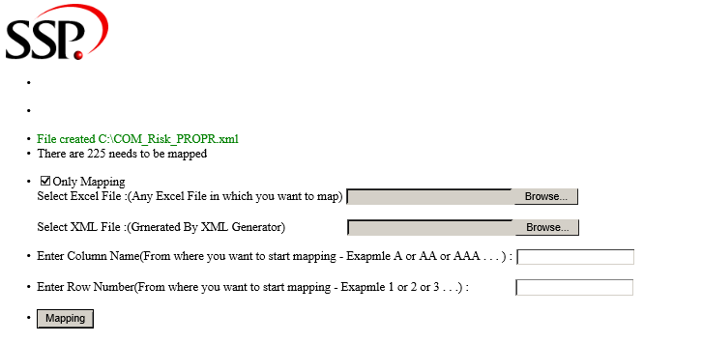
Now if you want to update Column reference in Xml file and name in Excel Sheet.
Click on “Only Mapping” Check Box

Slide 8
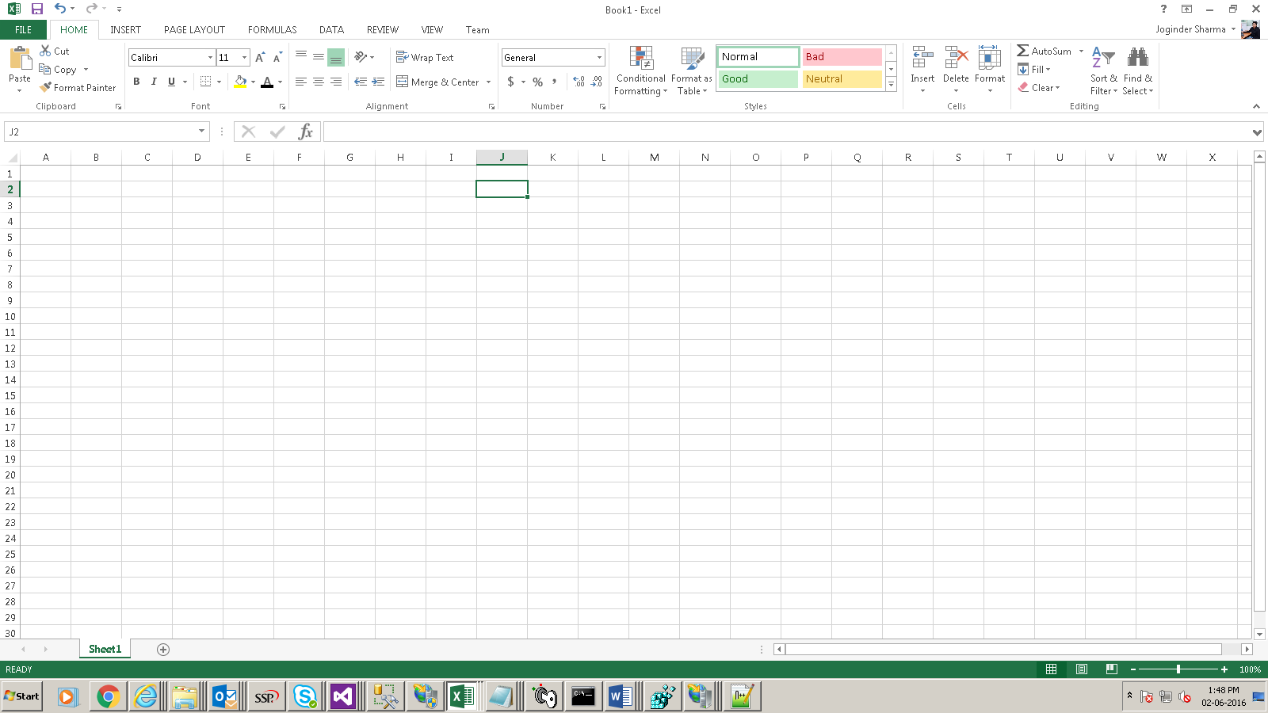
Here you will select Excel File and Xml file (which is generated previously).
And also set column reference and row number from Excel Sheet

Slide 9
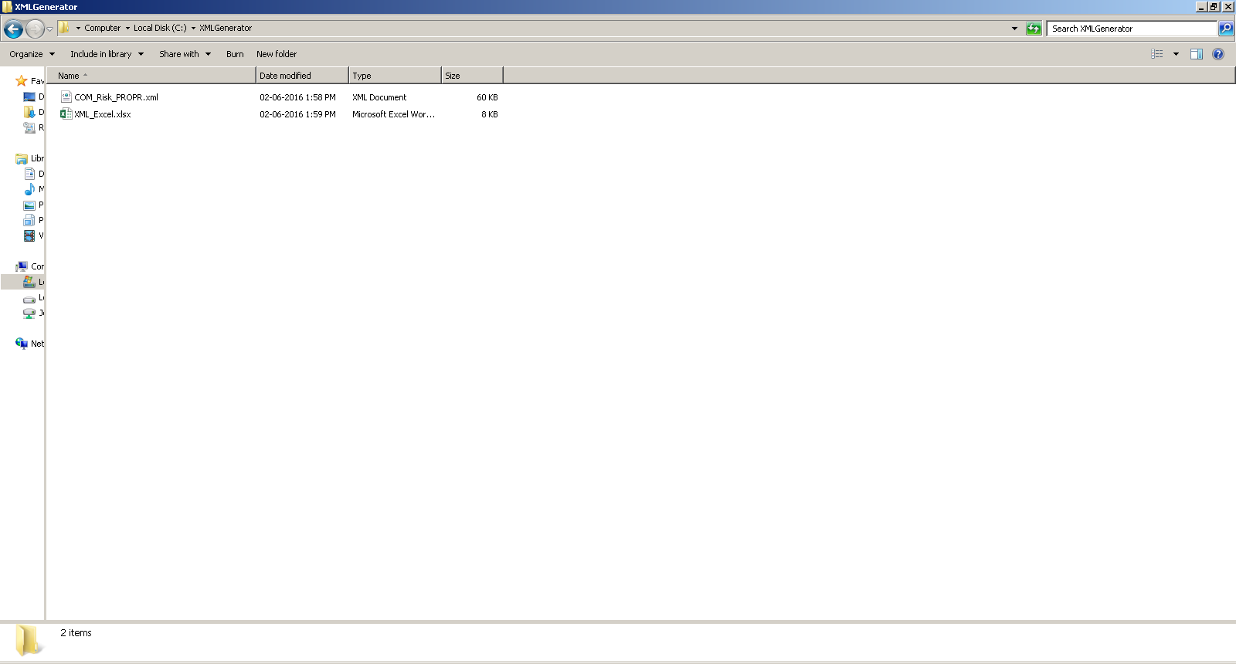
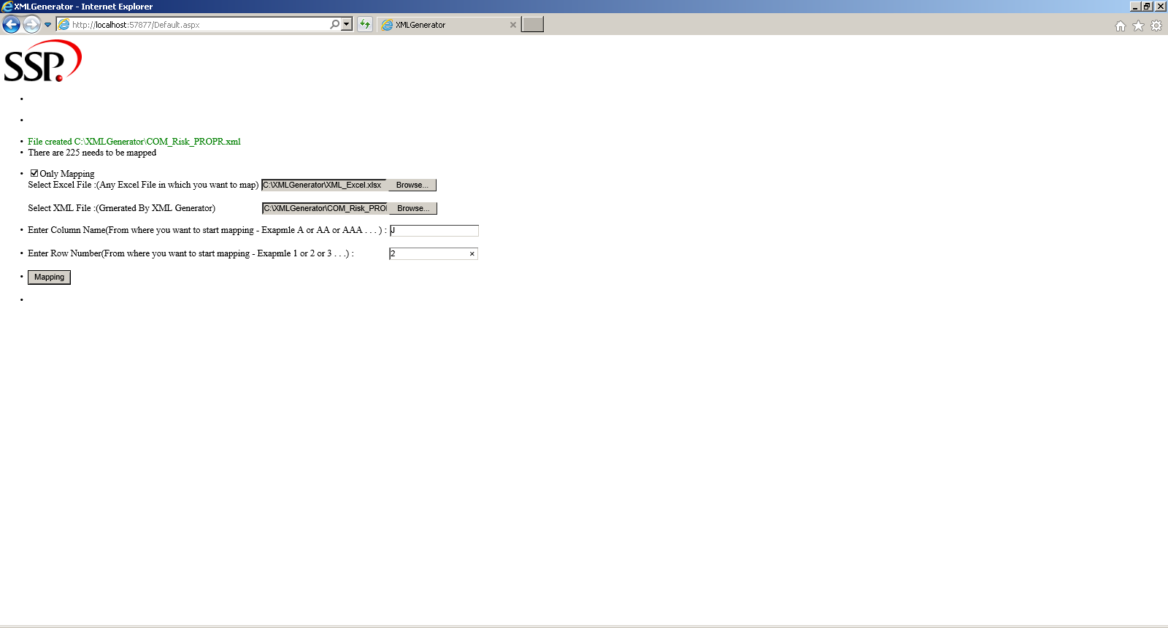

Slide 10
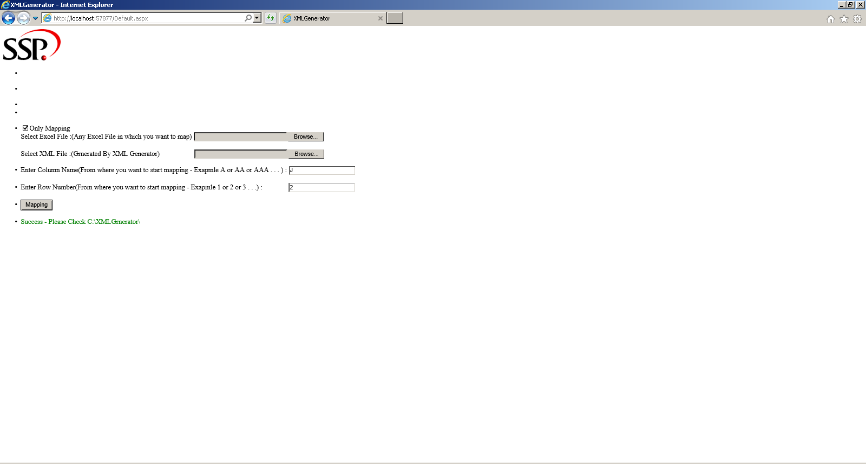
Click on Mapping:

Slide 11
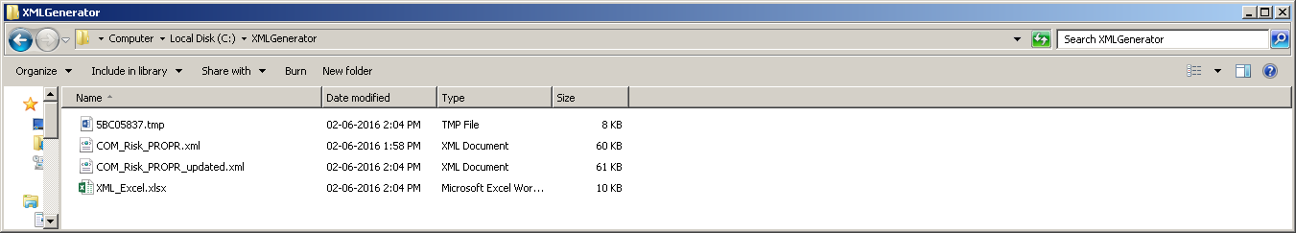
Check Folder “ C:\XMLGenerator\”

Slide 12
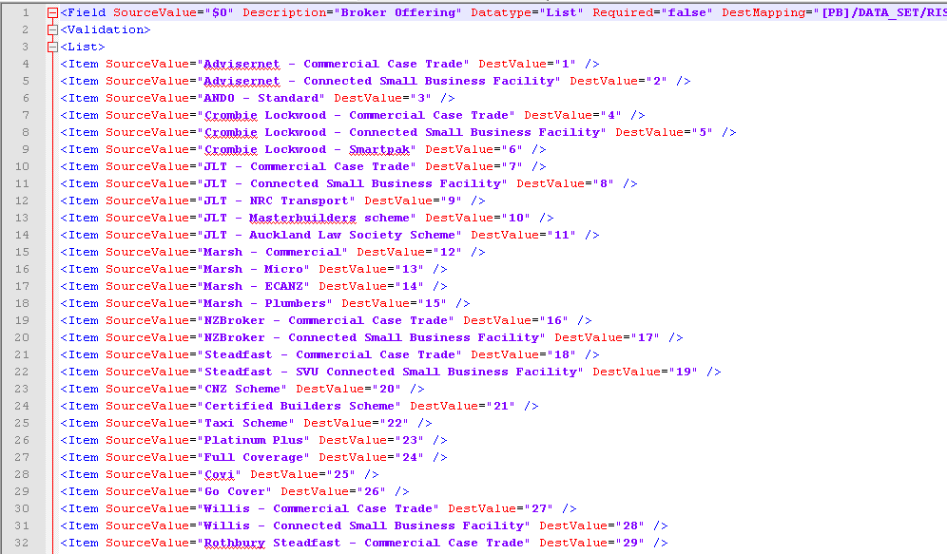
Open _updated.xml and Excel file :

Slide 13
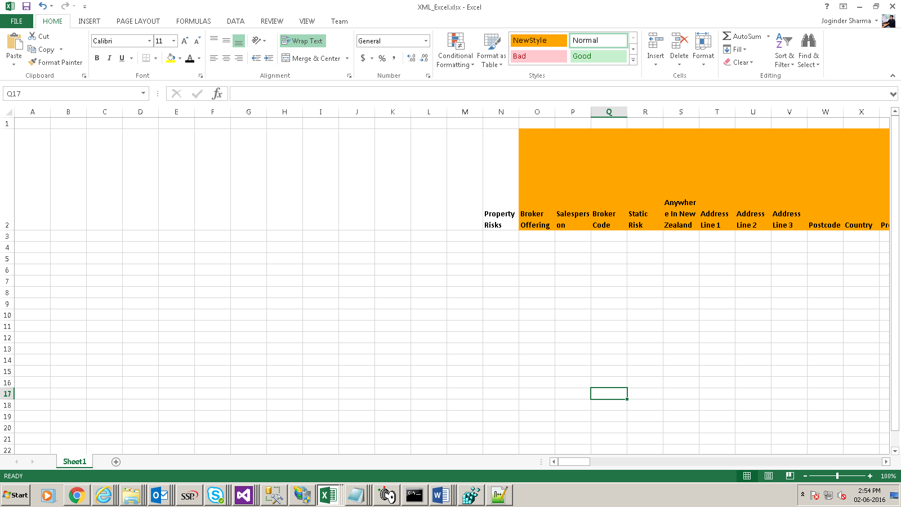
Fields are mapped from O(J+5 → Because it will skip 5 column for manual update)

Slide 14
Areas To Improve
Core Fields
Edit Single Column
Design View
Set Validation

Slide 15
Demo

Slide 16
Questions ?
Thank You !

